Slide 1

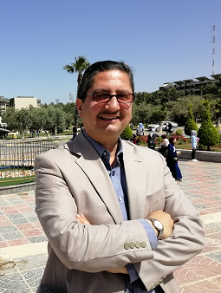
Clustering using K-Means Algorithm: An Example
Dr. Qasem Al-Radaideh
Yarmouk University
JORDAN

Slide 2
Example 4:
Given the following dataset (D),
Cluster the instances into 2 clusters using
K-Means clustering method and the
Euclidian distance. (Use First Way )
A2 | A1
15 | 10
11 | 8
12 | 12
18 | 15
3 | 16
6 | 4
8 | 9
X1
X2
X3
X4
X5
X6
X7

Slide 3
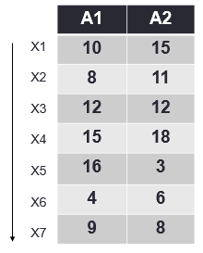
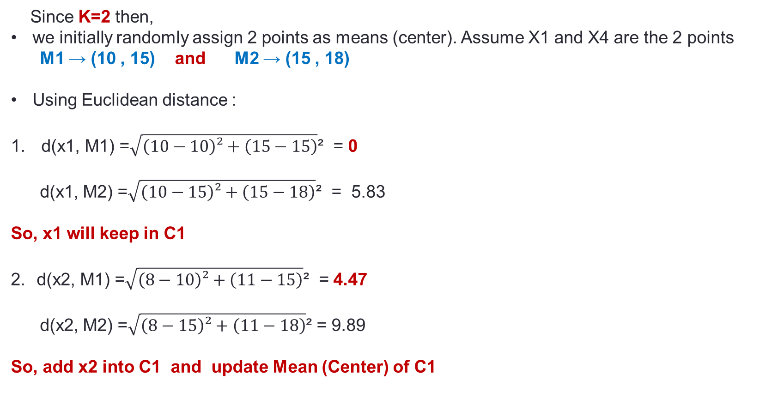
Solution
First iteration:
Since K=2 then,
we initially randomly assign 2 points as means (center). Assume X1 and X4 are the 2 points
M1 → (10 , 15) and M2 → (15 , 18)
Using Euclidean distance :
d(x1, M1) =$\sqrt{\left(10−10\right)²+\left(15−15\right)}$² = 0
d(x1, M2) =$\sqrt{\left(10−15\right)²+\left(15−18\right)}$² = 5.83
So, x1 will keep in C1
d(x2, M1) =$\sqrt{\left(8−10\right)²+\left(11−15\right)}$² = 4.47
d(x2, M2) =$\sqrt{\left(8−15\right)²+\left(11−18\right)}$² = 9.89
So, add x2 into C1 and update Mean (Center) of C1
C1
C2
x1 (10,15)
x4 (15,18)

Slide 4

c1
c2
Continue
Update M1: ( (10+8)/2) , (15+11)/2))
M1 ( 9,13)
M2 (15,18)
3. d(x3, M1 ) =$\sqrt{\left(12−9\right)²+\left(12−13\right)}$² = 3.1
d(x3, M2 ) =$\sqrt{\left(12−15\right)²+\left(12−18\right)}$² = 6.7
So, add x3 into C1 and Update center of C1
M1 ( (10+8+12)/3 , (15+11+12)/3)
M1 ( 10,12.6)
M2 (15,18)
X1(10,15)
X2(8 , 11)
X4 (15,18)
c1
c2
X1(10,15)
X2(8 , 11)
X3(12,12)
X4 (15,18)

Slide 5
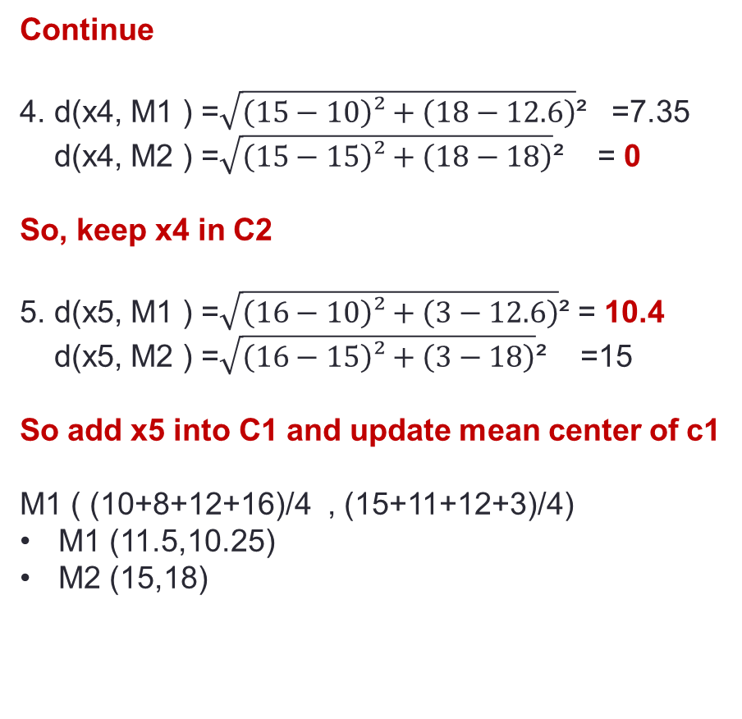
c2
Continue
4. d(x4, M1 ) =$\sqrt{\left(15−10\right)²+\left(18−12.6\right)}$² =7.35 d(x4, M2 ) =$\sqrt{\left(15−15\right)²+\left(18−18\right)}$² = 0
So, keep x4 in C2
5. d(x5, M1 ) =$\sqrt{\left(16−10\right)²+\left(3−12.6\right)}$² = 10.4 d(x5, M2 ) =$\sqrt{\left(16−15\right)²+\left(3−18\right)}$² =15
So add x5 into C1 and update mean center of c1
M1 ( (10+8+12+16)/4 , (15+11+12+3)/4)
M1 (11.5,10.25)
M2 (15,18)
c1
X1(10,15)
X2(8 , 11)
X3(12,12)
X5(16, 3)
X4 (15,18)

Slide 6
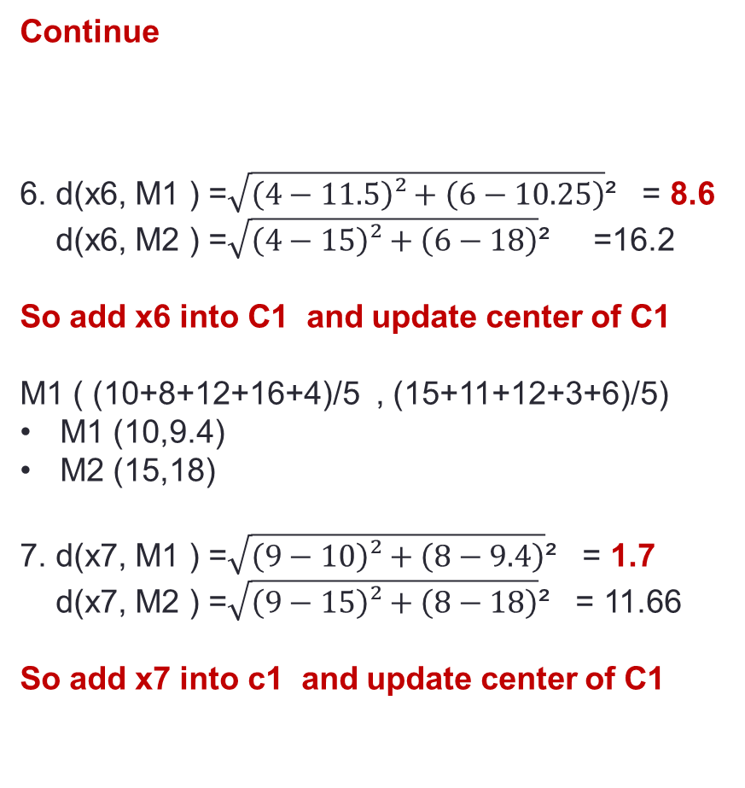
Continue
6. d(x6, M1 ) =$\sqrt{\left(4−11.5\right)²+\left(6−10.25\right)}$² = 8.6
d(x6, M2 ) =$\sqrt{\left(4−15\right)²+\left(6−18\right)}$² =16.2
So add x6 into C1 and update center of C1
M1 ( (10+8+12+16+4)/5 , (15+11+12+3+6)/5)
M1 (10,9.4)
M2 (15,18)
7. d(x7, M1 ) =$\sqrt{\left(9−10\right)²+\left(8−9.4\right)}$² = 1.7 d(x7, M2 ) =$\sqrt{\left(9−15\right)²+\left(8−18\right)}$² = 11.66
So add x7 into c1 and update center of C1
C1
C2
X1(10,15)
X2(8 , 11)
X3(12,12)
X5(16, 3)
X6(4, 6)
X7(9, 8)
X4(15,18)

Slide 7
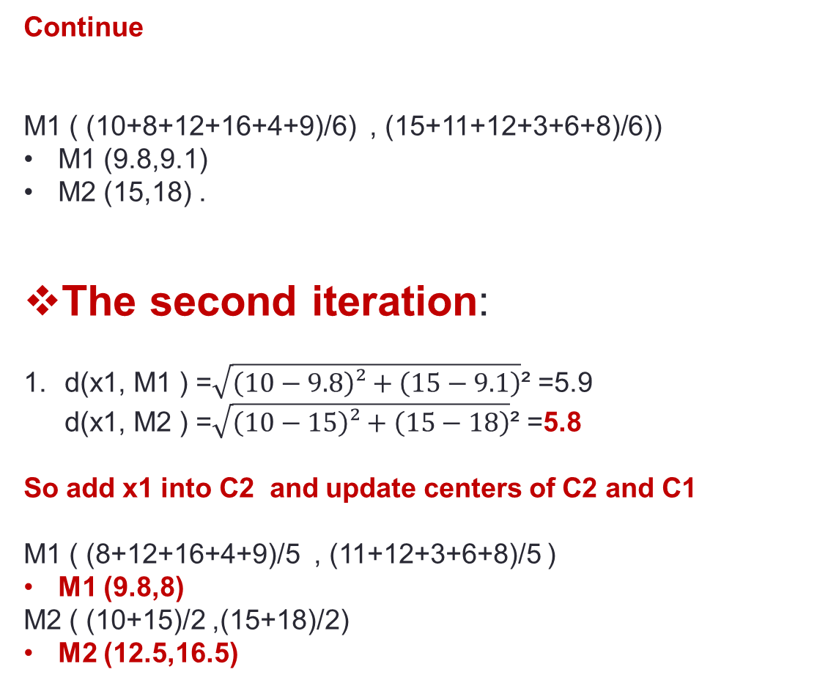
Continue
M1 ( (10+8+12+16+4+9)/6) , (15+11+12+3+6+8)/6))
M1 (9.8,9.1)
M2 (15,18) .
The second iteration:
d(x1, M1 ) =$\sqrt{\left(10−9.8\right)²+\left(15−9.1\right)}$² =5.9 d(x1, M2 ) =$\sqrt{\left(10−15\right)²+\left(15−18\right)}$² =5.8
So add x1 into C2 and update centers of C2 and C1
M1 ( (8+12+16+4+9)/5 , (11+12+3+6+8)/5 )
M1 (9.8,8)
M2 ( (10+15)/2 ,(15+18)/2)
M2 (12.5,16.5)
C1
C2
X2(8 , 11)
X3(12,12)
X5(16, 3)
X6(4, 6)
X7(9, 8)
X1(10,15)
X4(15,18)

Slide 8
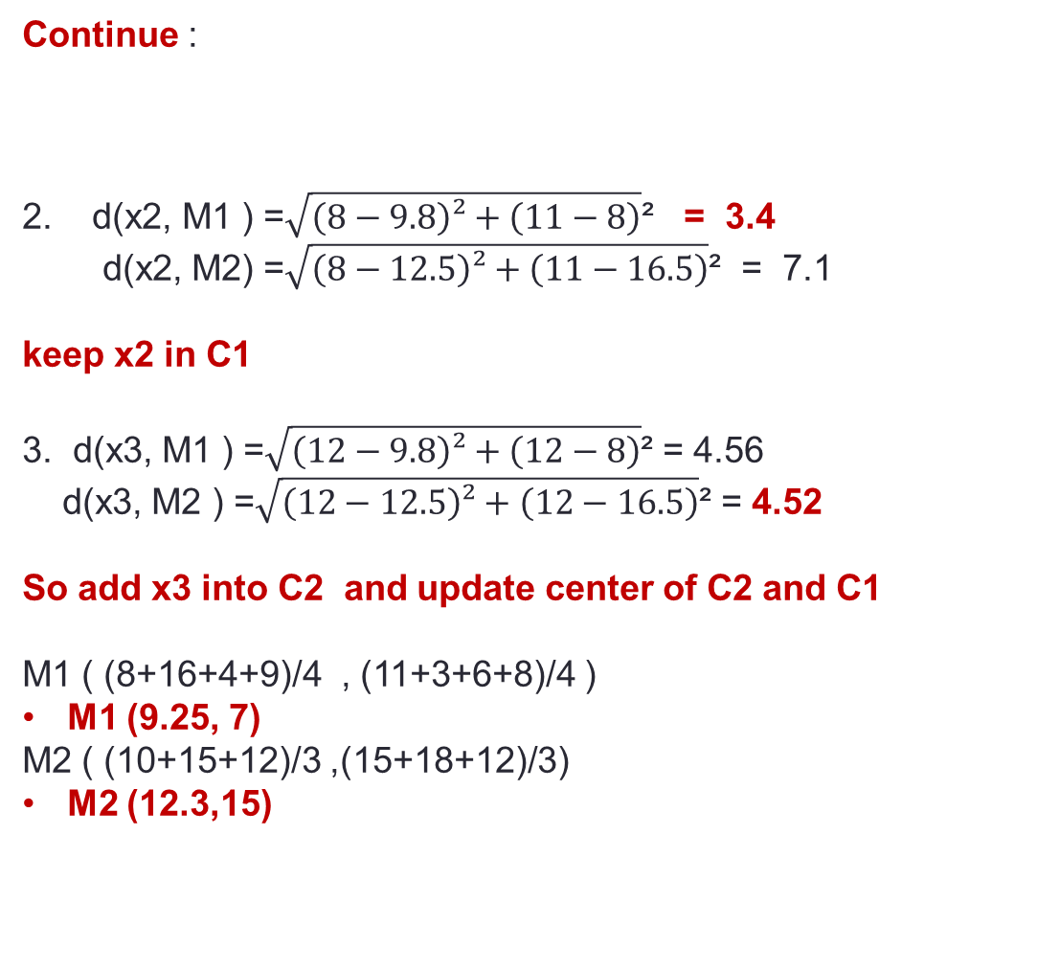
Continue :
2. d(x2, M1 ) =$\sqrt{\left(8−9.8\right)²+\left(11−8\right)}$² = 3.4
d(x2, M2) =$\sqrt{\left(8−12.5\right)²+\left(11−16.5\right)}$² = 7.1
keep x2 in C1
3. d(x3, M1 ) =$\sqrt{\left(12−9.8\right)²+\left(12−8\right)}$² = 4.56
d(x3, M2 ) =$\sqrt{\left(12−12.5\right)²+\left(12−16.5\right)}$² = 4.52
So add x3 into C2 and update center of C2 and C1
M1 ( (8+16+4+9)/4 , (11+3+6+8)/4 )
M1 (9.25, 7)
M2 ( (10+15+12)/3 ,(15+18+12)/3)
M2 (12.3,15)
C1
C2
X2(8 , 11)
X5(16, 3)
X6(4, 6)
X7(9, 8)
X1(10,15)
X3(12,12)
X4(15,18)

Slide 9
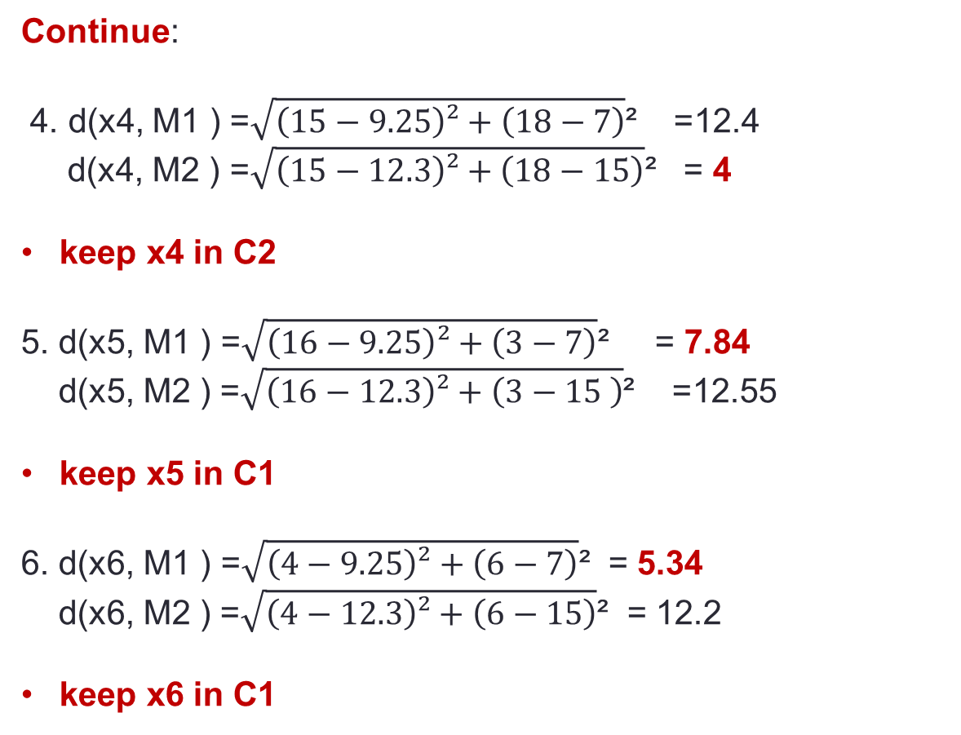
C1
C2
Continue:
4. d(x4, M1 ) =$\sqrt{\left(15−9.25\right)²+\left(18−7\right)}$² =12.4 d(x4, M2 ) =$\sqrt{\left(15−12.3\right)²+\left(18−15\right)}$² = 4
keep x4 in C2
5. d(x5, M1 ) =$\sqrt{\left(16−9.25\right)²+\left(3−7\right)}$² = 7.84 d(x5, M2 ) =$\sqrt{\left(16−12.3\right)²+\left(3−15 \right)}$² =12.55
keep x5 in C1
6. d(x6, M1 ) =$\sqrt{\left(4−9.25\right)²+\left(6−7\right)}$² = 5.34
d(x6, M2 ) =$\sqrt{\left(4−12.3\right)²+\left(6−15\right)}$² = 12.2
keep x6 in C1
X2(8 , 11)
X5(16, 3)
X6(4, 6)
X7(9, 8)
X1(10,15)
X3(12,12)
X4(15,18)

Slide 10
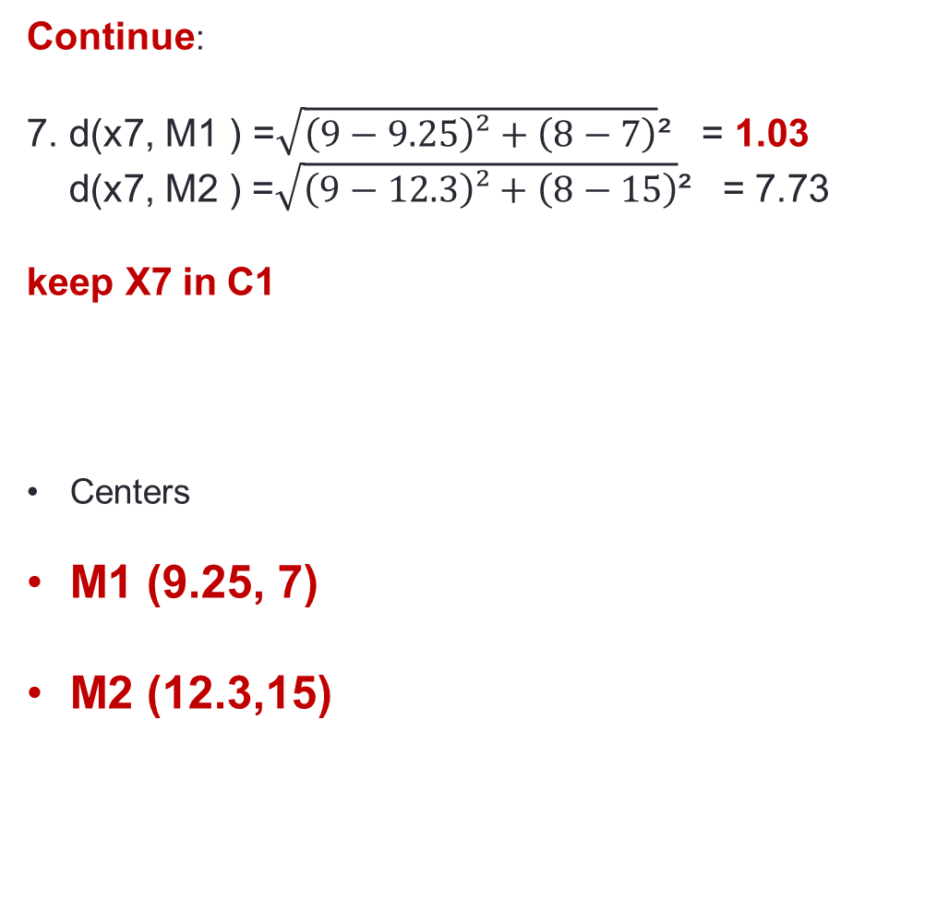
Continue:
7. d(x7, M1 ) =$\sqrt{\left(9−9.25\right)²+\left(8−7\right)}$² = 1.03 d(x7, M2 ) =$\sqrt{\left(9−12.3\right)²+\left(8−15\right)}$² = 7.73
keep X7 in C1
Centers
M1 (9.25, 7)
M2 (12.3,15)
C1
C2
X2(8 , 11)
X5(16, 3)
X6(4, 6)
X7(9, 8)
X1(10,15)
X3(12,12)
X4(15,18)

Slide 11
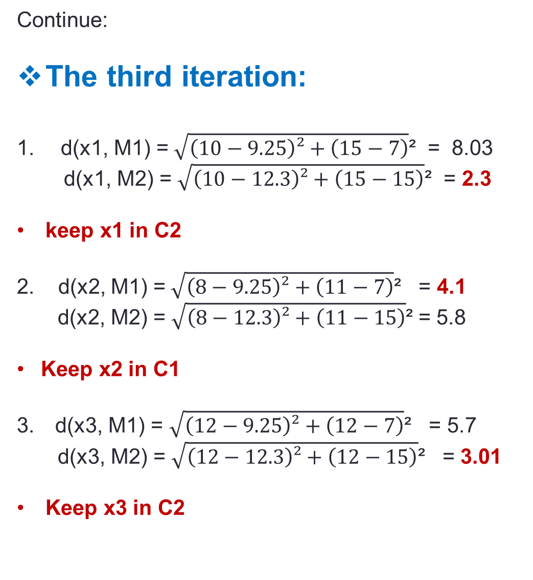
Continue:
The third iteration:
d(x1, M1) =$\sqrt{\left(10−9.25\right)²+\left(15−7\right)}$² = 8.03
d(x1, M2) = $\sqrt{\left(10−12.3\right)²+\left(15−15\right)}$² = 2.3
keep x1 in C2
2. d(x2, M1) =$\sqrt{\left(8−9.25\right)²+\left(11−7\right)}$² = 4.1
d(x2, M2) =$\sqrt{\left(8−12.3\right)²+\left(11−15\right)}$² = 5.8
Keep x2 in C1
d(x3, M1) = $\sqrt{\left(12−9.25\right)²+\left(12−7\right)}$² = 5.7
d(x3, M2) =$\sqrt{\left(12−12.3\right)²+\left(12−15\right)}$² = 3.01
Keep x3 in C2
C2
C1
X2(8 , 11)
X5(16, 3)
X6(4, 6)
X7(9, 8)
X1(10,15)
X3(12,12)
X4(15,18)
M1 (9.25, 7)
M2 (12.3,15)

Slide 12
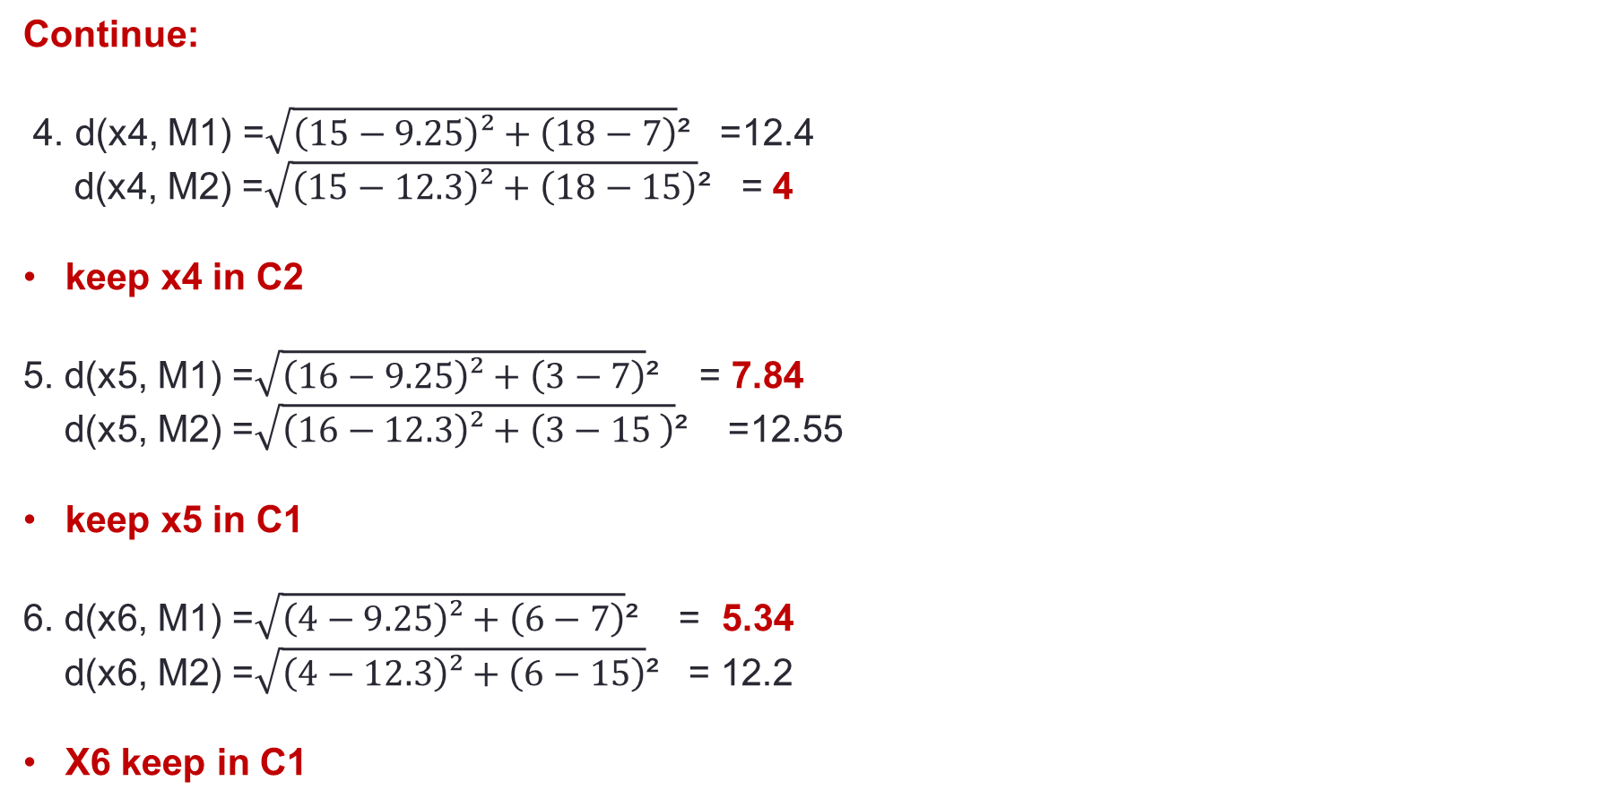
C2
C1
Continue:
4. d(x4, M1) =$\sqrt{\left(15−9.25\right)²+\left(18−7\right)}$² =12.4 d(x4, M2) =$\sqrt{\left(15−12.3\right)²+\left(18−15\right)}$² = 4
keep x4 in C2
5. d(x5, M1) =$\sqrt{\left(16−9.25\right)²+\left(3−7\right)}$² = 7.84 d(x5, M2) =$\sqrt{\left(16−12.3\right)²+\left(3−15 \right)}$² =12.55
keep x5 in C1
6. d(x6, M1) =$\sqrt{\left(4−9.25\right)²+\left(6−7\right)}$² = 5.34
d(x6, M2) =$\sqrt{\left(4−12.3\right)²+\left(6−15\right)}$² = 12.2
X6 keep in C1
X2(8 , 11)
X5(16, 3)
X6(4, 6)
X7(9, 8)
X1(10,15)
X3(12,12)
X4(15,18)

Slide 13
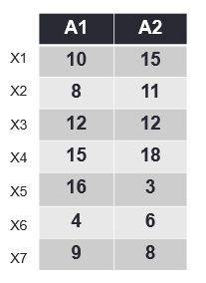

Continue:
7. d(x7, M1) =$\sqrt{\left(9−9.25\right)²+\left(8−7\right)}$² = 1.03 d(x7, M2) =$\sqrt{\left(9−12.3\right)²+\left(8−15\right)}$² = 7.73
Keep x7 in C1
Since no changes happened to all points,
So, Stop iteration.
Final Clusters
Final Centers: M1(9.25, 7) M2(12.3,15)
c1
c2
X2(8 , 11)
X5(16, 3)
X6(4, 6)
X7(9, 8)
X1(10,15)
X3(12,12)
X4(15,18)

